Slide 1
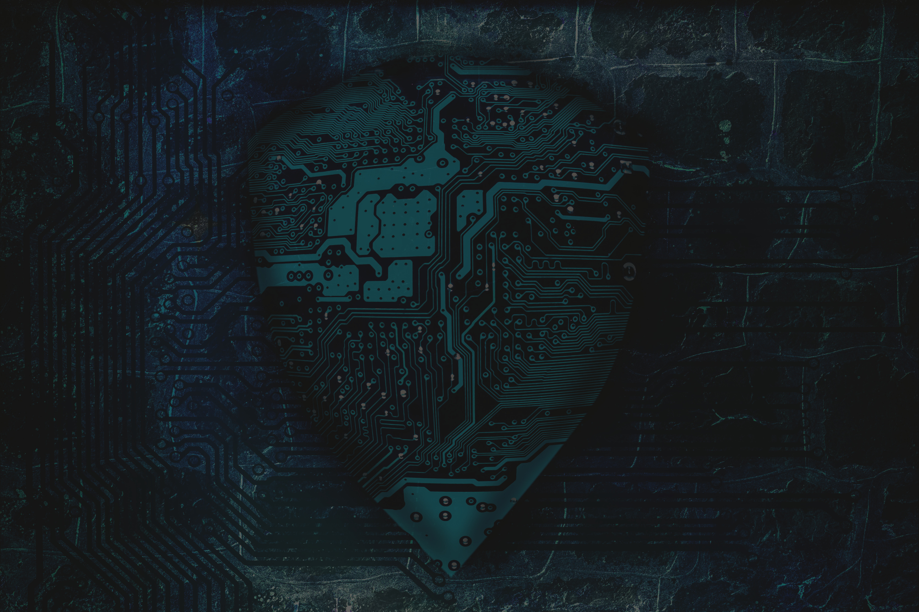

rimberio
Cybersecurity
in 2025
Defending the Digital Frontier
LEARN MORE

Slide 2


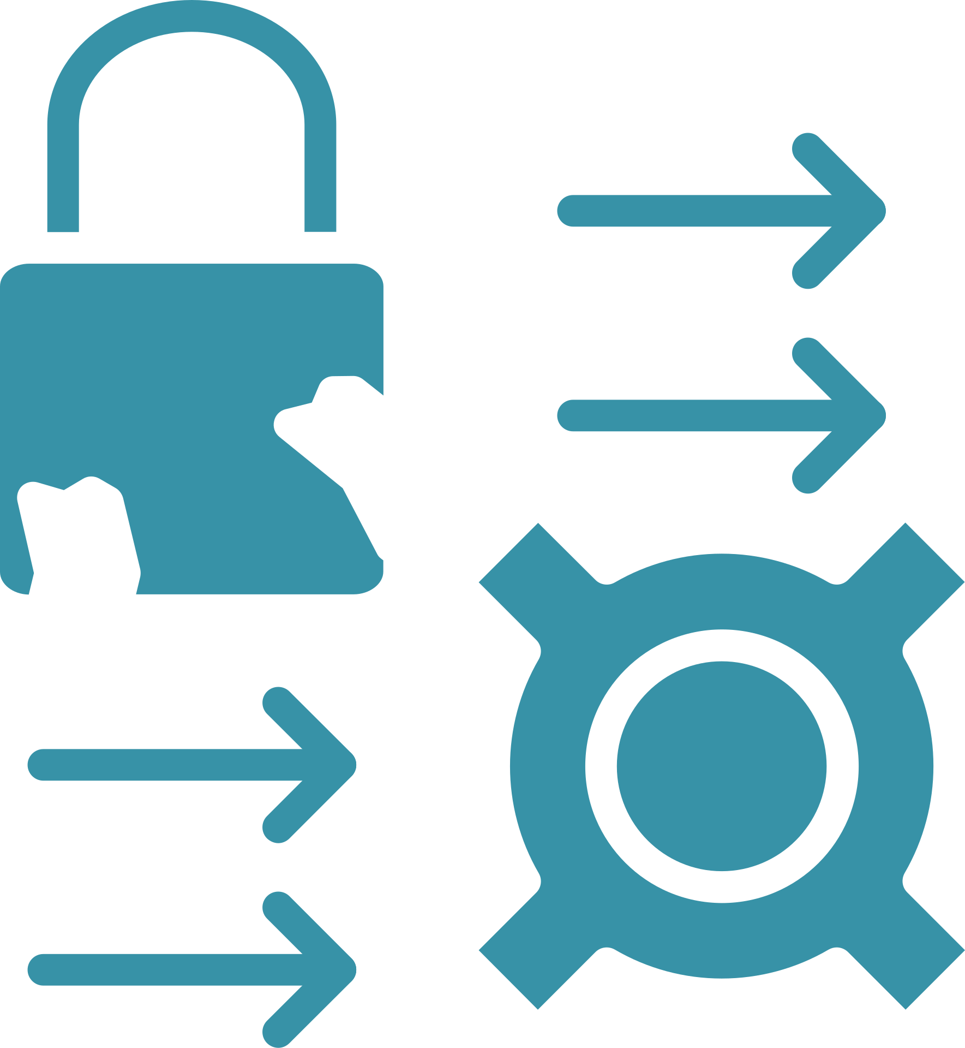

What is
Cybersecurity?
Digital Protection
Breach Prevention
Safeguards systems, networks, and data from unauthorized access and attacks.
Implements controls to prevent data theft, system damage, and service disruption.
Comprehensive Approach
Combines technology, processes, and human awareness to create defense layers.

Slide 3

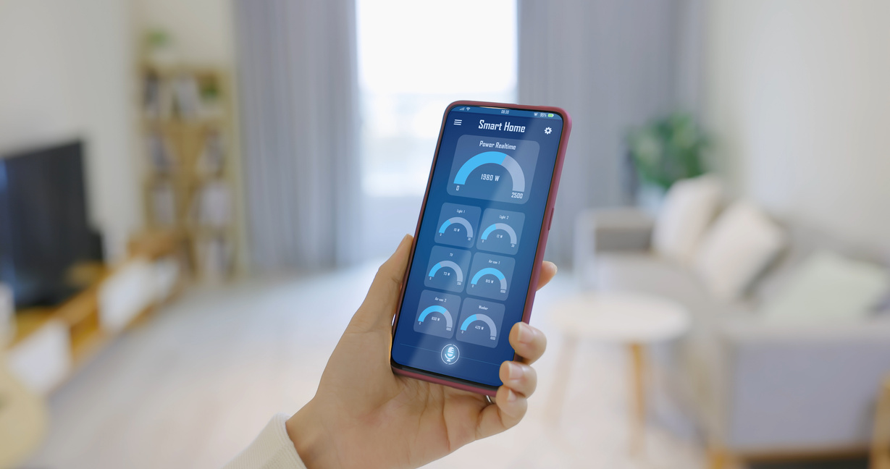
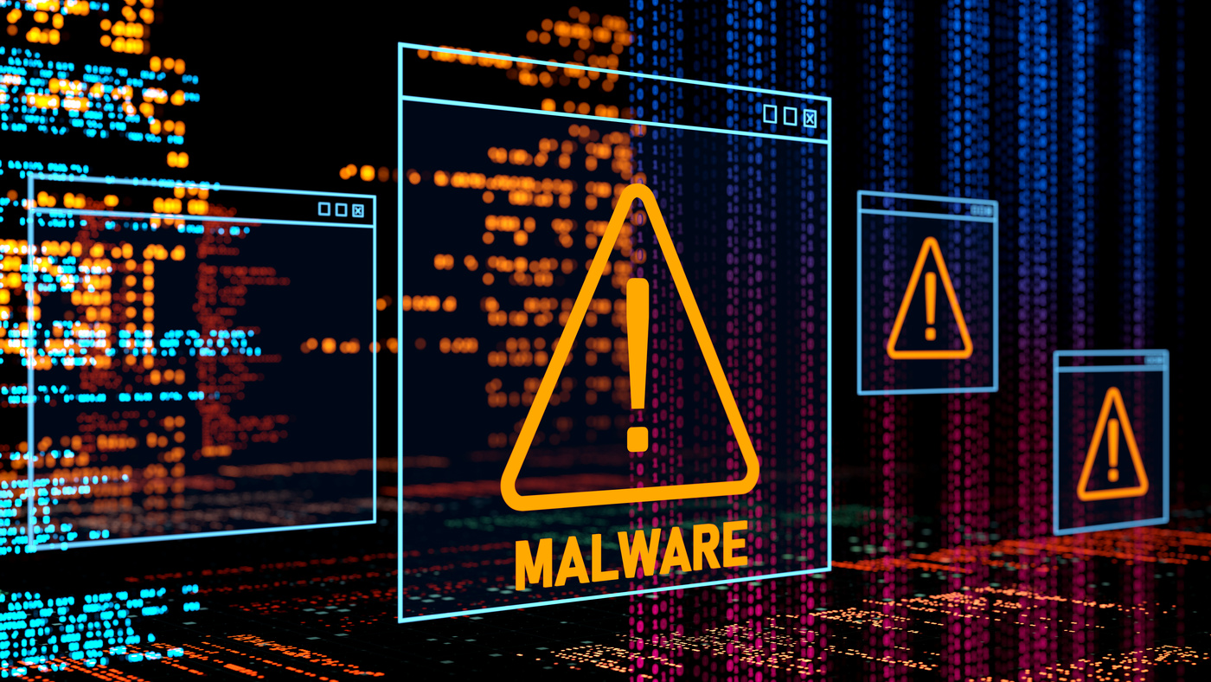
The Evolving
Threat Landscape
AI-Powered Attacks
Expanded Attack Surface
Traditional Threats
Adaptive malware that evolves to evade detection
Cloud environments, IoT, and remote work endpoints
Enhanced phishing, ransomware, and social engineering

Slide 4
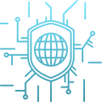
Most Common Cyber
Attack Vectors
Phishing Campaigns
Social Engineering
Deceptive emails, texts, and social media messages targeting credentials.
Manipulating people to divulge confidential information.
Malware & Ransomware
Infrastructure Attacks
Increasingly sophisticated payloads using AI to avoid detection.
Targeting critical systems, cloud platforms, and supply chains.

Slide 5


Security Awareness:
The Human Element
Human Risk
Training
82% of breaches involve human factors through social engineering.
Regular simulated phishing tests and security awareness programs.
Mobile Security
Authentication
Secure device management and application controls.
Strong password policies plus multi-factor authentication.

Slide 6
Technology Defenses & AI:
Double-Edged Sword
AI for Defense
Quantum-Safe Future
AI for Attacks
Detects unknown threats
Responds faster than humans
Adapts to evolving attacks
Developing resistant algorithms
Preparing for quantum threats
Updating encryption standards
Creates realistic phishing
Builds evolving malware
Automates attack processes

Slide 7
Securing the Remote and Hybrid Workforce
74% Remote Adoption
Network Vulnerabilities
Most organizations now support hybrid or fully remote work models.
Unsecured home networks and public Wi-Fi create exposure points.
Critical Controls
Training Imperative
VPNs, endpoint protection, and zero trust architecture mitigate risks.
Remote workers need specialized security awareness education.

Slide 8
Cloud & Mobile: New Security Frontiers
Cloud Challenges
Mobile Risks
Shared responsibility models require clear security boundaries.
Data sovereignty concerns affect global operations.
Misconfigurations remain the top cloud vulnerability.
Device loss and theft expose sensitive data.
Malicious apps compromise corporate networks.
BYOD policies create security management challenges.
Zero Trust Approach
Verify every access request, regardless of source.
Limit access to only what's necessary.
Continuously monitor and validate trust.

Slide 9
Cybersecurity Policy and Ethics
Regulatory Compliance
Ethical Balancing
Responsible Practices
GDPR, CCPA, and industry regulations dictate minimum standards
Privacy vs. security requires thoughtful consideration
Ethical hacking and vulnerability disclosure protect communities

Slide 10
Conclusion: Building Resilience for 2025 and Beyond
Anticipate Evolution
Integrate Defense Layers
Cyber threats continuously adapt. Our defenses must evolve faster.
Combine technology, training, and policies for comprehensive protection.
Foster Shared Responsibility
Everyone plays a crucial role in maintaining security.

